Slide 1


A Project On Food Delivery System : SwaadSaathi

Slide 2
Submitted in partial fulfilment of the requirements of the degree of
BACHELOR OF TECHNOLOGY
Submitted by
Daksh Sharma (Roll No - 20ETCCS024 , Enrollment No. – 20E1TCCSM40P024)
Dikshant Dak (Roll No - 20ETCCS034, , Enrollment No. – 20E1TCCSM40P034)
Dhruv Paliwal (Roll No - 20ETCCS033, Enrollment No. – 20E1TCCSM40P033)
Paramveer Singh Rathore (Roll No - 20ETCCS082, Enrollment No. – 20E1TCCSM40P082)
Lakshya Khandelwal (Roll No - 20ETCCS067, Enrollment No. – 20E1TCCSM40P067)
Jainam Jain(20ETCCS056, , Enrollment No. – 20E1TCCSM40P056)

Slide 3
COMPUTER SCIENCE DEPARTMENT
TECHNO INDIA NJR INSTITUTE OF TECHNOLOGY, UDAIPUR MAY 2024

Slide 4
GROUP NAME: The Boyz
FOOD DELIVERY SYSTEM – SwaadSaathi

Slide 5
PROBLEM STATEMENT
In contemporary food delivery systems, a prevalent issue lies in the limited customization options offered to users, hindering their ability to tailor orders according to personal preferences or dietary restrictions. For instance, customers with specific dietary requirements, such as gluten-free or vegan preferences, often face challenges in accurately conveying their needs. Current platforms may lack detailed customization features, making it difficult for users to specify ingredient preferences, cooking methods, or portion sizes. This restriction not only compromises user satisfaction but also poses potential health concerns. Addressing this issue is imperative to create a more inclusive and user-friendly food delivery system that caters to the diverse and unique preferences of customers, ultimately enhancing their overall dining experience.

Slide 6
OBJECTIVE AND SCOPE OF PROJECT
The project aims to develop a user-friendly web platform that enables restaurant owners to easily partner with food delivery agencies. The system will facilitate registration, profile creation, order management, and communication between restaurants and delivery agencies. The scope includes a secure login system, order tracking, real-time notifications, and feedback mechanisms for both parties.
Objective:
Enhance food delivery systems by providing users with robust customization options, addressing the current limitation in personalizing orders. The project aims to improve user satisfaction and cater to diverse dietary preferences.
Scope:
Redesign and augment existing platforms to incorporate advanced customization features, including detailed order personalization. Collaborate with restaurants to ensure seamless integration and accurate conveyance of specific dietary needs. Conduct thorough testing for effectiveness and user-friendliness, with the ultimate goal of creating a more inclusive and
satisfying food delivery experience.

Slide 7

METHODOLOGY
Creating a food delivery system involves various functionalities to ensure a seamless experience for both customers and businesses. Here are essential features and functionalities you may want to consider:
1. User Registration and Authentication:
2. Browse and Search:
3. Menu Display:
4. Order Placement:
5. Payment Integration:
6. Real-Time Tracking:
7. Push Notifications:
8. User Reviews and Ratings:
9. User Profiles:
10: Restaurant Dashboard

Slide 8
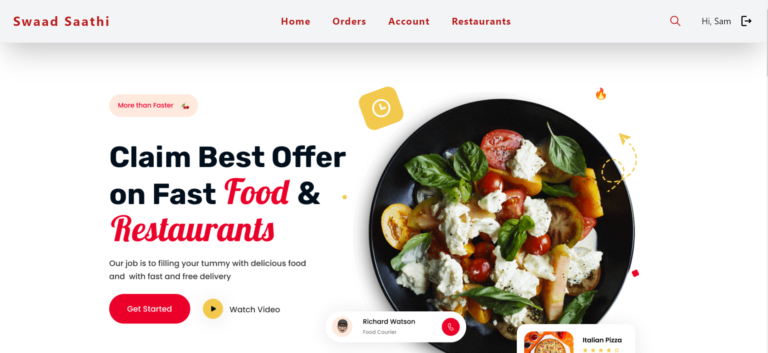
Home Page :-
HARDWARE:
Laptop: Basic Requirement –
Windows 10/11,GarudaLinux, i5,i7 11gen processor, 5gb Memory space, 8gb to 16gb RAM
Internet Facilities.
SOFTWARE:
Frontend: Javascript/TypeScript, React.JS/Next.JS, Ant-Design
Backend: GraphQL, Node.JS, Express.JS, ORM,PostgreSql as Database
APIs: Google Maps for location services, Payment Gateway, Rapid Api
Development Tools: VS Code, Git for version control, ThunderClient/Postman for API testing

Slide 9
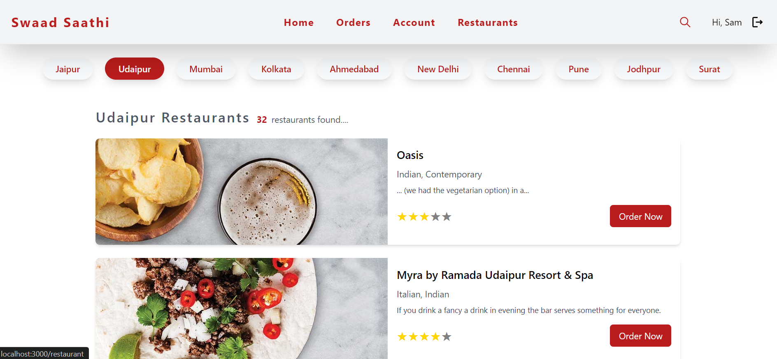
Restaurants Page :-

Slide 10
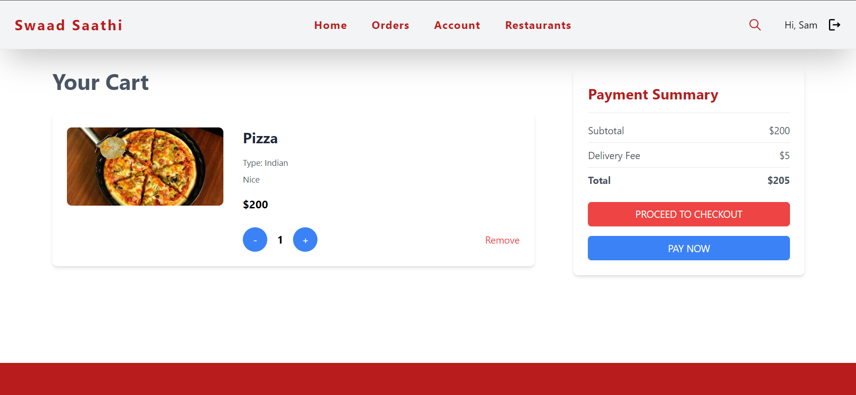
Cart page: -

Slide 11
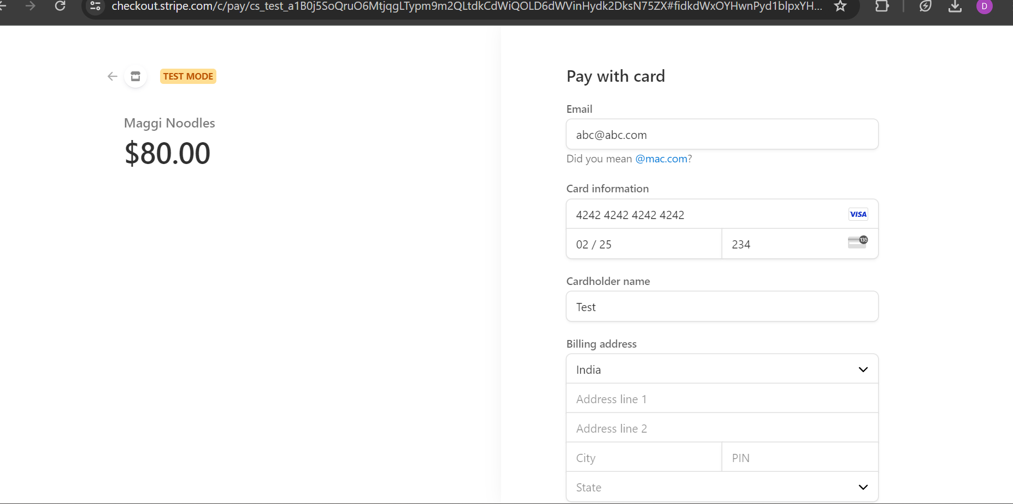
Stripe Payment Integration :-

Slide 12
APPLICATION AND FUTURE SCOPE OF PROJECT
Application of the Project:
1. Enhanced User Experience:
- Users enjoy a more personalized and satisfying dining experience by customizing orders to their preferences and dietary needs.
2. Competitive Advantage:
- Food delivery platforms gain a competitive edge with unique customization features, leading to increased customer satisfaction and loyalty.
Future Scope of the Project:
3. Global Expansion:
- Successful implementation sets the stage for global expansion, catering to diverse markets with varying culinary preferences.
4. Integration with Emerging Technologies:
- Explore AI and machine learning integration for personalized recommendations, ensuring the project remains innovative and technologically advanced.

Slide 13
PROJECT TIMELINE
Project Initiation
2 weeks
Requirement Analysis and Planning
1 week
Competitor Analysis
1 week
Technology Assessment and Selection
2 weeks
User Interface Design
3 weeks
Backend Development
3 weeks
Integration with Restaurants
2 weeks
Testing and Quality Assurance
1 week
User Education and Communication
2 weeks
Launch and Monitoring
2 weeks
Continuous Improvement
1 week

Slide 14
REFERENCES / BIBLIOGRAPHY
Rest API Documentation
TypeScript Documentation
ORM Documentation
Node.js Documentation
Next.js Documentation
React.js Documentation
Google Maps Platform Documentation
PostgreSql Documentation

